Slide 1
THE ART OF REVIEW WRITING
UNIT-V : REVIEW OF FILM
Prepared by
B.RASHMA M.A.,NET
ASSISTANT PROFESSOR OF ENGLISH
JAMAL MOHAMED COLLEGE

Slide 2
OVERVIEW
Introduction
What is a film review?
Importance of film
Role and responsibilities of a reviewer.
Movie review elements

Slide 3


INTRODUCTION

Slide 4
WHAT IS A FILM REVIEW ???
FR is the analysis of the film made by one person or collectively expressing the opinion on the movie.
  film
    plot
    characters
    Opinion and recommendation
    direction

Slide 5
Cont….
It is a short description of a film
It is written to give a brief description and evaluation of a movie
At the beginning it is vital to mention the reputation of actors and director and write what your expectations were and whether they were fulfilled
The review should be concise and engaging
It gives viewers someone's opinion and recommendation about whether (or not) they should watch a film.

Slide 6
IMPORTANCE OF FILM
The importance film/cinema differs from person to person. For eg:
Medium for communication and entertainment
Purpose behind the commercial film is to make a profit and to attract and keep the audience had to be appealing and entertaining.
An artist take it as art.
The public might take it as entertainment

Slide 7
Cont…..
Effects of watching movies:
Movies relax our mind
Movies educate us
It teaches how to deal with situations.
Movies spread awareness
Movies make us laugh and cry
Movies inspire us.

Slide 8
Role and Responsibilities of a Reviewer
Reviewers have a significant role and responsibilities towards authors(directors), editors and readers(audience).
To guide the reader through the movie: its narrative and cinematography, the different layers of characters and to underline why it is an interesting piece of art or not.

Slide 9

Cont….
Avoid personal comments
or criticism
Maintaining the confidentiality
of the review process.
Not sharing, discussing
with third parties.
Suggest improvements
that need to be added

Slide 10
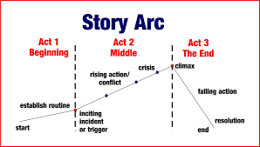
MOVIE REVIEW ELEMENTS
10 ESSENTIAL ELEMENTS
1.Plot
* The movie follows a story arc and plausibility.
STORY ARC

Slide 11
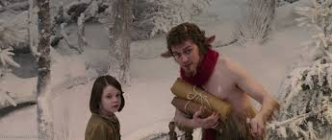
Cont….
PLAUSIBILITY:
1)Fictional stories
2)Movies based on
true Stories.

Slide 12
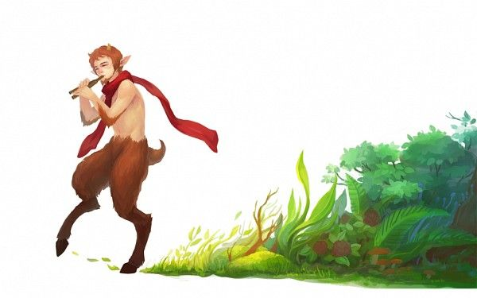
Mr. Tumnus

Slide 13
2. ATTRACTION
TRAILER
*series of selected shots from the film being advertised.
* It is primarily created to show the audience what the film is about and to encourage them to see it when it is released.
ENTERTAINMENT VALUE
*movie should keep us engaged & entertained
*make a delicate balance
*adopt different genres

Slide 14
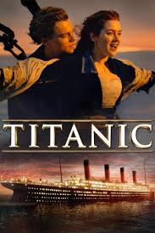
3.THEME
The themes are identifiable and intriguing.
IDENTITY:
i)themes and sub-themes?
ii) message of the movie rather than entertainment.
iii)make us to feel what really special in the movie
Notes:
* interest

Slide 15
Cont….
INTRIGUE (INTEREST)
To be intriguing themes should achieve at least one of the following:
teach us something
Make us think
Form an emotional connection with us.

Slide 16
4.ACTING
THE CHARACTERS ARE MULTIDIMENSIONAL AND THE ACTING SHOULD BE CONVINCING.
1.Characters : characters are based on people, and people are multifaceted with their own hopes ,desires, faults and aspirations. So the characters should not be so different.
2. Performance:
* Actor should not imitate.
* The actor should become the character.

Slide 17
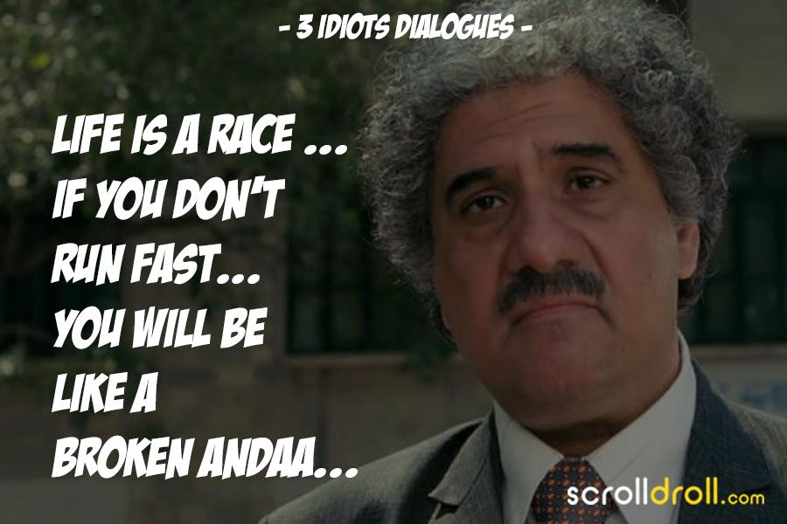

5.DIALOGUE

Slide 18
6.CINEMATOGRAPHY what we see inside the frame is the important aspect of cinemat…
VISUAL LANGUAGE
Continuity is king. This concept goes beyond the camera technique.
The shot selection, the angles, all of it should mix. Catchy to eyes. Adding creative ideas.
LIGHTING ,SETTING ,WARDOBE
Lighting- tell us how to feel
Setting – tell us where we are
Wardrobe_ tell us who the characters are
eg: painting

Slide 19
7.EDITING AND EFFECTS
1.pace and tone
pace is to hold our attention.
Tone is important in expressing what the movie is trying to communicate to the audience.
2. Effects (vfx/sfx)
Visual effects and special effects.

Slide 20
8.SOUND AND MUSIC
The music is harmonious and the sound design is authentic.
Music – Harmony( the combination of simultaneously sounded musical notes to produce a pleasing effect)
music should be in sync with the story
compatible with the mood and its corresponding scene.
Theme music should be memorable
It should connect to the soul

Slide 21
Cont…
Sound – AUTHENTICITY
Music should be unique
Pleasing to the ears
Good sound mixing and mastering is essential to keep the audience immersed and entertained.

Slide 22
9.DIRECTION
VISION
follow their own unique creative process
direction should a unified vision.
EXECUTION
    The movie should be so well told
    so well crafted
    That the story cannot be told any other way.
    The plot should be flawless and every element of the cinema scale should execute to perfection

Slide 23
10.The “it” factor
1) One-of -a-kind: A movie is a one of a kind when it is original, innovative and pioneering.
Eg: AVATAR
2) Above and beyond:
*It is beyond comprehension, you can’t explain why you love it.
*experiencing different feeling.
*feeling more connected

Slide 24


